Slide 1

Stress and
Posttraumatic Stress in Paramedics
Elizabeth Donnelly, PhD, MPH, LICSW, NREMT
SWORBHP Prehospital and Transport Medicine Research Day
June 19, 2018
London, ON
Notes:
Discuss the empirical and theoretical underpinnings of research into stress reactions in EMS
Review the results of three research studies into stress in EMS
Discuss implications for the field

Slide 2
So, is it stressful to work as a paramedic?
Yes.
Critical incident stress
  Any situation faced by personnel that causes them to experience unusually strong emotional reactions that have the potential to interfere with their ability to function on scene or after the call.
Every day stresses (chronic stress)
  Enduring problems, conflicts, and threats that many people face in their daily lives.

Slide 3

Chronic stresses in paramedicine
Organizational stress
  Stressors associated with the organizational culture
Operational stress
  Stress associated with doing the job
Notes:
Organizational Stress
Feeling like different rules apply to different people (e.g. favoritism)
Feeling like you always have to prove yourself to the organization
Constant changes in policy/legislation
Staff shortages
Bureaucratic red tape
Lack of training on new equipment
Dealing with supervisors
Lack of resources
Unequal sharing of work responsibilities
Leaders over-emphasize the negatives (e.g. supervisor evaluations, public complaints)
Operational stress
Shift work
Risk of being injured on the job
Managing your social life outside of work
Friends/family feel the effects of the stigma associated with your job
Eating healthy at work
Fatigue
Lack of understanding from your friends and family about your work
Making friends outside of the job
Negative comments from the public
Feeling like you are always on the job

Slide 4
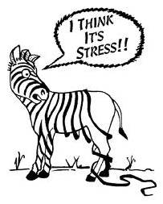
How do we react to work stress?
Workplace stress has been linked with
  Low job satisfaction
  Poor physical health
  Depression
  Fatigue
  Burnout
  Posttraumatic stress
Notes:
Influences on work behavior….

Slide 5
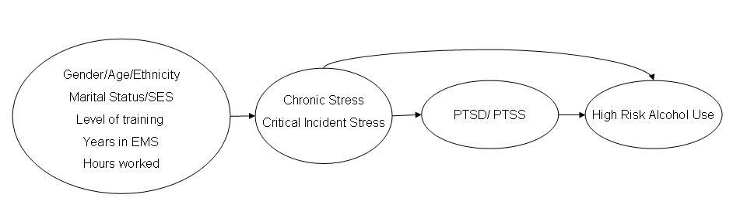
How does it all go together?
Who are you?
Type of stress?
Severity?
How do you react to stress?
Donnelly, E. A. & Siebert, D. C. (2009). Occupational risk factors in the emergency medical services. Prehospital and Disaster Medicine, 24(5) 428-435. doi:10.1017/S1049023X0000725

Slide 6
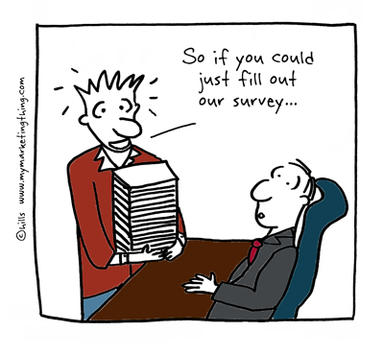
Study #1:
Testing the theoretical model
Probability sample of 12,000 EMTs and paramedics from the NREMT
Contacted via email, invited to complete a survey
Survey included questions about:
  Chronic operational stress
  Chronic organizational stress
  Critical incident stress
  Posttraumatic stress
  Alcohol use
  Demographics

Slide 7
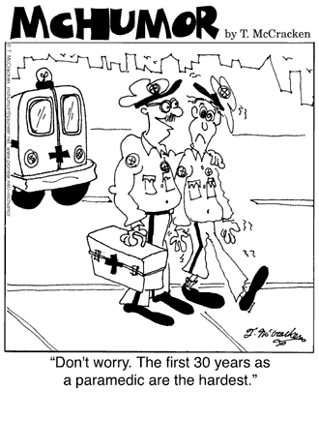
Results:
Critical Incident and Posttraumatic stress
Top 5 most stressful critical incidents were:
  Saw someone dying
  Encountered the body of someone recently dead
  Encountered an adult who had been badly beaten
  Responded to a scene involving family, friends, or others known to the crew
  Encountered an adult who had been sexually assaulted.
6% of the sample met criteria for PTSD
Notes:
PTSD score range was 0 to 60. Cutoff for PTSD was 35

Slide 8
more results…
49.2% of respondents reported using alcohol to cope with a bad call or shift
83.7% reported seeing co-workers use alcohol to cope with a bad call or shift.
Controlling for length of service, age, gender, hours worked, income, level of training, and marital status….
Operational stress, organizational stress, critical incident stress, and alcohol use were significant predictors of posttraumatic stress (p<.01)

Slide 9
1+1 = 5?
All three kinds of stress and alcohol use increased the risk for posttraumatic stress
However, operational stress has another way of increasing the risk of posttraumatic stress
Operational stress interacts with critical incident stress and alcohol use to further increase the risk of posttraumatic stress
Notes:
Synergistic reaction…

Slide 10
What does it all mean?
Critical incident stress isn’t the only source of stress in EMS
  Operational stress, organizational stress, and alcohol use also increase the risk of posttraumatic stress
High levels of operational stress, combined with high levels of alcohol use or critical incident stress further increase risk for a posttraumatic stress reaction.
Donnelly, E. A. (2012). Work-related stress and posttraumatic stress in the emergency medical services. Prehospital Emergency Care, 16(1), 76-85. doi:10.3109/10903127.2011.62104
Notes:
Publications regarding the measures-
Donnelly, E. A., Chonody, J., & Campbell, D. (2014). Measuring chronic stress in the Emergency Medical Services. Journal of Workplace Behavioral Health, 29(4), 333-353. doi: 10.1080/15555240.2014.96582
Donnelly, E. A., & Bennett. M. (2014). Development of a critical incident stress inventory for the Emergency Medical Services. Traumatology. 20(1), 1-8. doi: 10.1177/1534765613496646

Slide 11
Study #2:
Stress in the Canadian Context
Replication and extension of Study #1
Participants from one EMS Service in Southwest Ontario
Survey included questions about:
  Chronic operational stress
  Chronic organizational stress
  Critical incident stress
  Posttraumatic stress
  Alcohol use
  Demographics
Preferred sources of social support in managing work-related stress

Slide 12
RESULTS
5.6% exceeded the cutoff for PTSD
Controlling for length of service, age, gender, hours worked, income, level of training, and marital status….
Operational stress and Operational stress x critical incident stress remained significant predictors of PTSS (p<.01).
Note: this study did not replicate the significant relationship between PTSS and organizational stress or alcohol use.

Slide 13
Results - Preferred sources of social support for managing work related stress
A family member or friend 81.4%
Your partner 73.2%
A co-worker 49.7%
The employee assistance program/another therapist 38.6%
A union representative 22.1%
A supervisor 17.2%
A base hospital educator 7.6%
Donnelly, E. A., Bradford, P., Davis, M., Hedges, C., & Klingel, M. (2015). Predictors of posttraumatic stress and preferred sources of social support in Canadian paramedics. Canadian Journal of Emergency Medicine, 1-8. doi:10.1017/cem.2015.92

Slide 14
What does it all mean?
Operational stress appears to have the same relationship to PTSS in the Canadian context
The other findings weren’t replicated, which may be due to
  Structural differences
  Sample size
Clear differences in preferred sources of support
  May provide support for peer-driven interventions

Slide 15

Study #3:
Stress and Safety
Replication, expansion, and extension of previous studies
Involved 10 EMS services in Ontario, multiple waves of data collection
Assessed chronic and critical incident stress, posttraumatic stress, fatigue, and safety outcomes
  Paramedic injury
  Medical errors
  Safety compromising behaviors
Supported by a grant from the Paramedic Chiefs of Canada
Notes:
Injury – being injured, needle stick, exposures
Error – Not placing a patient on a monitor, no ASA in STEMI, medication administration error
Safety compromising behavior – speeding, reporting for work after drinking alcohol or getting adequate rest, fudging patient care reports,

Slide 16
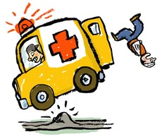
results
In the past three months…
80.2% of paramedics reported being injured or exposed to a pathogen
95.3% reported safety compromising behaviors
76.4% reported making medical errors
54.9% reported being fatigued at work
14.5% met the clinical cut off for probable PTSD

Slide 17
Results: Fatigue
If a paramedic reported being fatigued, they were significantly more likely to report
  Injuries (OR 2.7, 95% CI 1.8, 4.0),
  Safety compromising behaviors (OR 3.9, 95% CI 1.6, 10.0),
  Medication errors (OR 1.6, 95% CI 1.1, 2.0).
Paramedics who rotate between day and night shifts were more likely to report injury and medication errors
Paramedics who worked 12 or more hours per shift were more likely to report injury and medication errors
Finally, paramedics who worked over 40 hours weekly were more likely to report injury and safety compromising behaviors

Slide 18
Results: Safety outcomes
Injury was significantly related to
  fatigue (p<.02),
  organizational stress (p<.05),
  critical incident stress (p<.01)
  PTSS (p<.01)
  Paramedic Service (p<.01).
Medication errors were significantly related to
  fatigue (p=.01)
  Paramedic Service (p<.05).
Safety compromising behaviors were significantly associated with
  fatigue (p<.01),
  organizational stress (p<.01),
  critical incident stress (p<.01),
  Paramedic Service (p<.05).

Slide 19
So what to do?
We need to better manage stress in EMS
  Think holistically and broaden our idea of workplace stress
Consider prevention efforts
  Education
  Mentorship
  Reduce stigma
Reduce risk by maximizing support
  Peer support programs
  Involving family
  Creating EMS specific stress reduction curricula
  Work for organizational change
Notes:
Education –
Increase stress awareness/management training as part of EMS curriculum
Consider stress management as part of recertification requirements
Mentorship-
“old hands” can model better strategies for coping by talking about their struggles
Reaching out when you see someone in trouble
Peer support-
Not “experts” or “one time deal” like CISD
Co-workers nominated for the role
Given basic training in psychological first aid
Access to resources
Note – if and how mental health help is available should be prominently advertised. Confidential. When and how to seek help should be discussed.

Slide 20
So what to do?
Make appropriate care available
  Use evidence based best practices
  Cultivate mental health professionals that speak the language
  Minimize barriers to accessing existing mental health services
More research
  What works? Evaluate existing and new interventions.
  What do we know about resilience in EMS?
Keep up the conversation!

Slide 21

Any questions?
If you have questions,
would like copies of any of this research,
or would like to continue the conversation,
please don’t hesitate to contact me!
Elizabeth A. Donnelly
donnelly@uwindsor.ca
www.uwindsor.ca/donnelly

